Slide 1
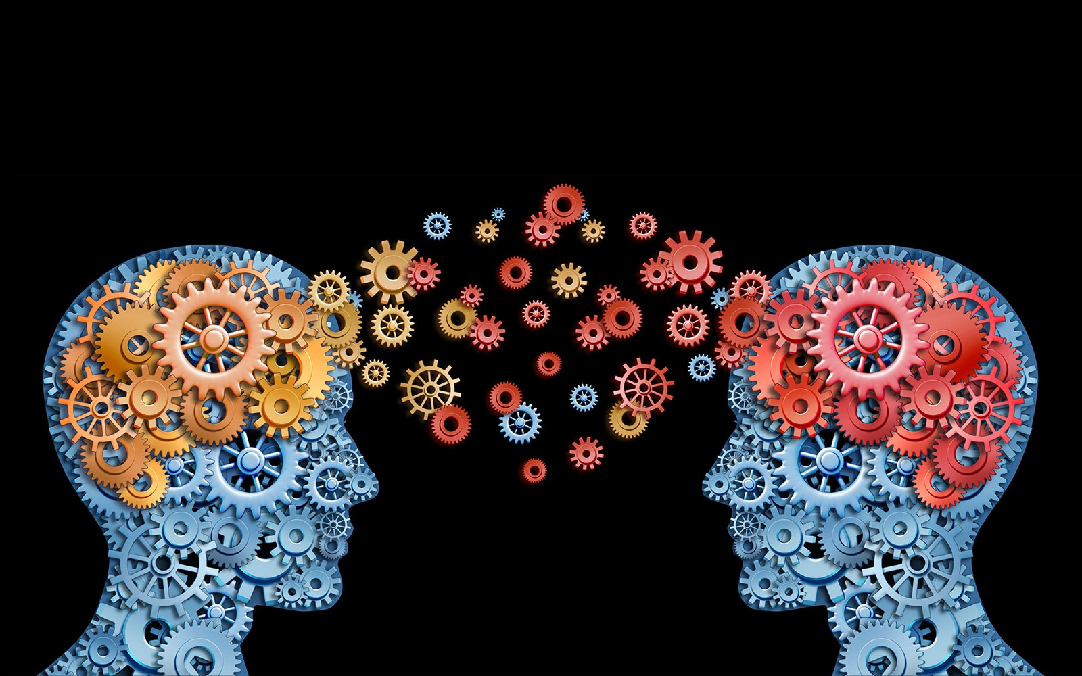





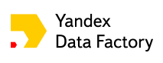




Flavours of Physics Challenge: Physics Prize Transfer Learning approach
Alexander Rakhlin rakhlin@gmx.net
DRAFT
Heavy Flavour Data Mining workshop 18 February 2016, Zurich

Slide 2
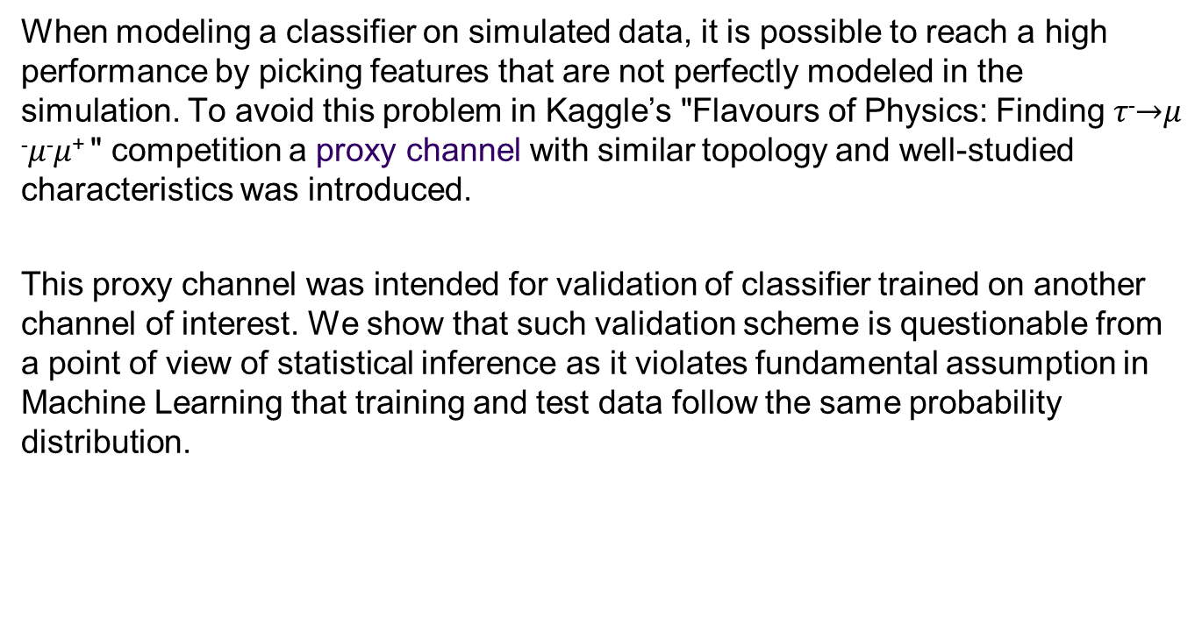
Abstract
When modeling a classifier on simulated data, it is possible to reach a high performance by picking features that are not perfectly modeled in the simulation. To avoid this problem in Kaggle’s "Flavours of Physics: Finding 𝜏⁻$→$𝜇⁻𝜇⁻𝜇⁺ " competition a proxy channel with similar topology and well-studied characteristics was introduced.
This proxy channel was intended for validation of classifier trained on another channel of interest. We show that such validation scheme is questionable from a point of view of statistical inference as it violates fundamental assumption in Machine Learning that training and test data follow the same probability distribution.

Slide 3
Proposed solution: Transfer Learning
We relate the problem to known paradigm in Machine Learning – Transfer Learning between different underlying distributions.
We propose a solution that brings the problem to transductive transfer learning (TTL) and simple covariate shift, a primary assumption in domain adaptation framework.
Finally, we present transfer learning model (one of a few) that finished the competition on the 5 place.

Slide 4
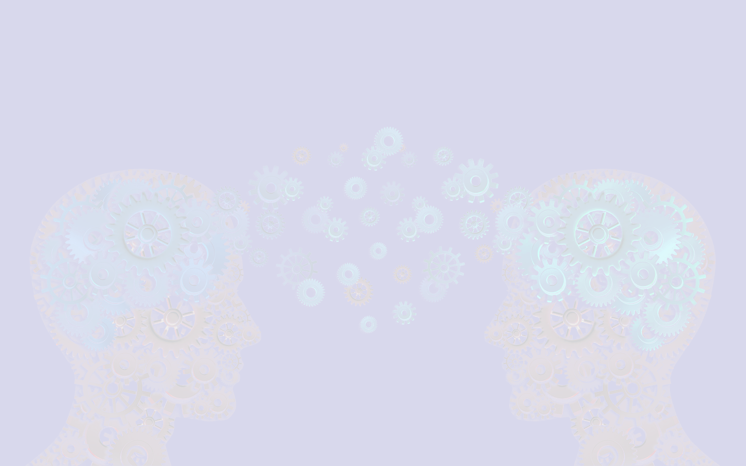
1. Introduction

Slide 5
Description
Like 2014’ Higgs Boson Kaggle Challenge, this competition dealt with the physics at the Large Hadron Collider.
However, the Higgs Boson was already known to exist. The goal of 2015’ challenge was to design a classifier capable to discriminate a phenomenon that is not already known to exist – charged lepton flavour violation – thereby helping to establish "new physics" (from the competition description)

Slide 6
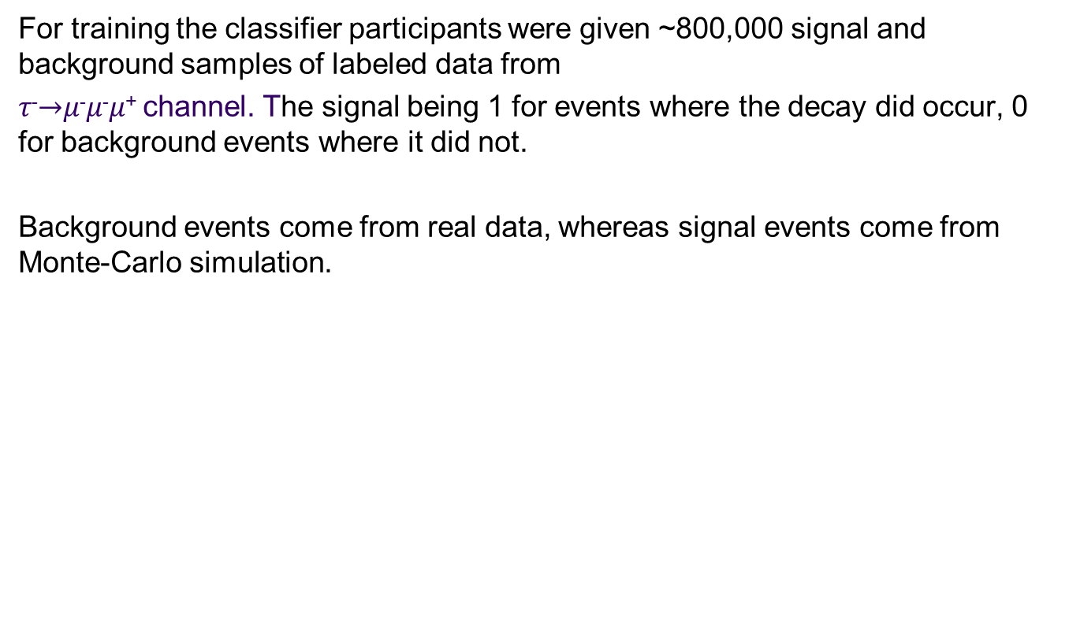
The data
For training the classifier participants were given ~800,000 signal and background samples of labeled data from
𝜏⁻$→$𝜇⁻𝜇⁻𝜇⁺ channel. The signal being 1 for events where the decay did occur, 0 for background events where it did not.
Background events come from real data, whereas signal events come from Monte-Carlo simulation.

Slide 7
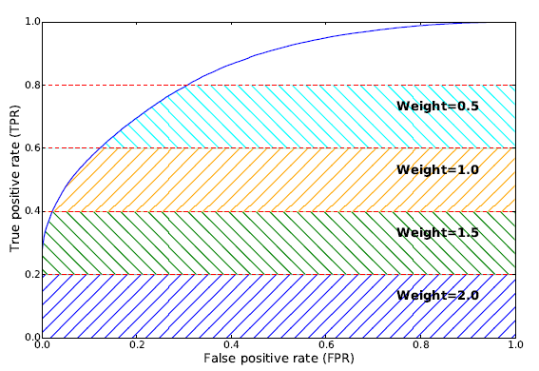
Evaluation
The evaluation metric for this competition is Weighted Area Under the ROC Curve:
Pic ?
From official documentation of the challenge

Slide 8


The challenge
Since the classifier was trained on simulated data for the signal and on real data for the background, it was possible to reach a high performance by picking features that are not perfectly modeled in the simulation.
To address this problem a classifier was required not to have large discrepancy when applied to data and to simulation. To this end, a Control channel with known characteristics was introduced. Kolmogorov–Smirnov test was used to make sure that classifier performance does not vary significantly between Signal and Control channels.

Slide 9
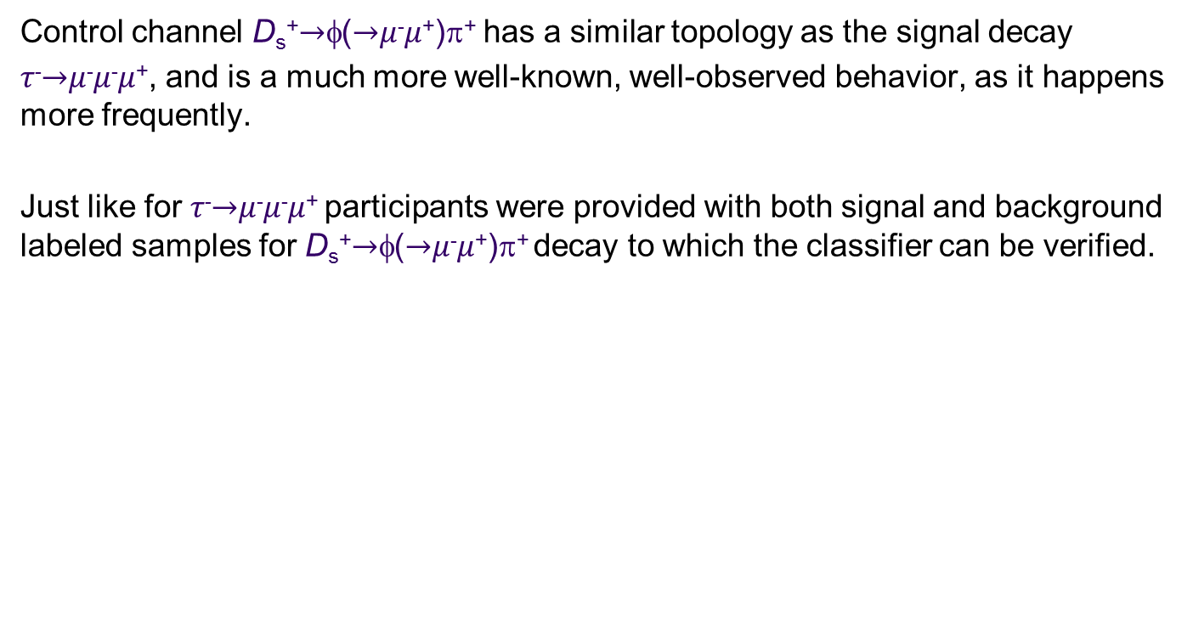
Control channel
Control channel D_{s}⁺$→$φ($→$𝜇⁻𝜇⁺)π⁺ has a similar topology as the signal decay
𝜏⁻$→$𝜇⁻𝜇⁻𝜇⁺, and is a much more well-known, well-observed behavior, as it happens more frequently.
Just like for 𝜏⁻$→$𝜇⁻𝜇⁻𝜇⁺ participants were provided with both signal and background labeled samples for D_{s}⁺$→$φ($→$𝜇⁻𝜇⁺)π⁺ decay to which the classifier can be verified.

Slide 10

No training on control channel allowed
Although the control data was labeled, it was not intended for training, its purpose was validation of already trained classifier.
This requirement became the main challenge of “Flavours of Physics: Finding 𝜏⁻$→$𝜇⁻𝜇⁻𝜇⁺“, and constitutes central point of this presentation.
This requirement became the main challenge of “Flavours of Physics: Finding 𝜏⁻→𝜇⁻𝜇⁻𝜇⁺“, and constitutes central point of this presentation.

Slide 11

The problem: validation on control channel is questionable
Machine Learning theory shall remind us why testing on data that has different probability distribution than data where the model was trained violates …
… the assumption of a single underlying generative process between the train set and the test set.
This assumption is the cornerstone of statistical learning and, in general, of inference.

Slide 12
Our plan
The following section is dedicated to foundations of Machine Learning theory. We will see that control and signal channels have different underlying probability distribution.
In “Transfer learning” section we propose a framework for learning from different distributions.
“Implementation” section discusses solution presented for this competition and sets some guidelines for further development.
“Kolmogorov–Smirnov test” section is optional but provides some interesting insight.

Slide 13
2. Brief review of Machine Learning foundations
Let us briefly recall the fundamentals of Machine Learning theory.

Slide 14
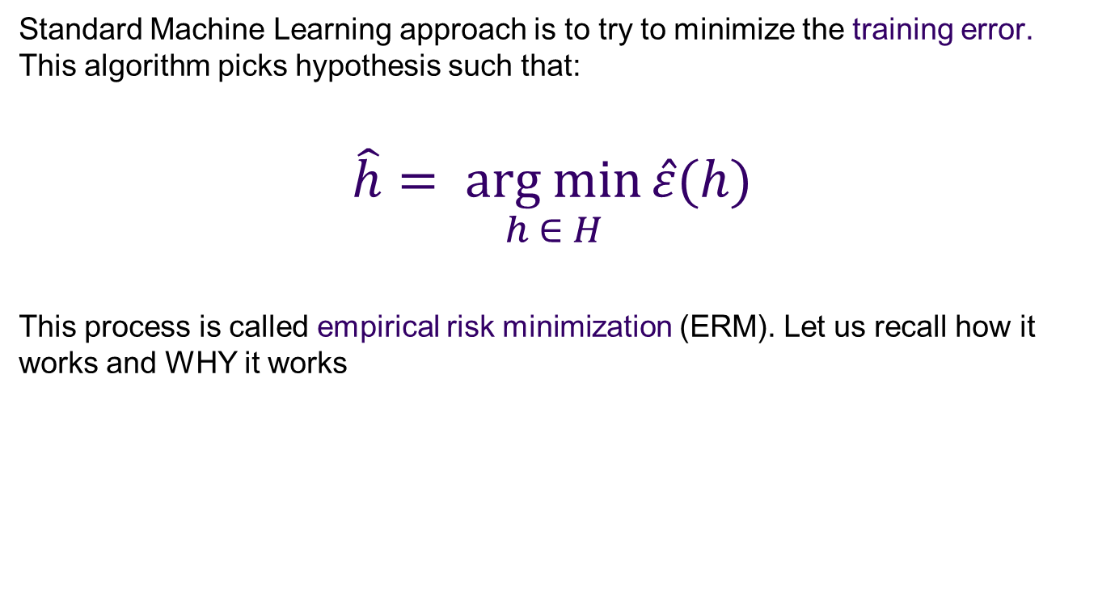
Empirical risk minimization
Standard Machine Learning approach is to try to minimize the training error. This algorithm picks hypothesis such that:
$$\hat{h}= \underset{h ∈ H}{arg min}{\hat{ε}(h)}$$
This process is called empirical risk minimization (ERM). Let us recall how it works and WHY it works

Slide 15
Building blocks of the general (supervised) statistical learning process
$(Xi, yi)$– set of independent and identically distributed (iid) training examples drawn from unknown input distribution $P(X)$
(𝑋_{𝑖}, 𝑦_{𝑖}) – set of independent and identically distributed (iid) training examples drawn from unknown input distribution 𝑃(𝑋)
H – hypothesis set, or the set of all classifiers considered by learning algorithm. This can be, for example, a set of all linear classifiers in $R^{n}$
H – hypothesis set, or the set of all classifiers considered by learning algorithm. This can be, for example, a set of all linear classifiers in 𝑅^𝑛
$f(x)$– unknown target function
𝑓(𝑥) – unknown target function
$g(x)$– hypothesis that learning algorithm picks to approximate $f(x)$
𝑔(𝑥) – hypothesis that learning algorithm picks to approximate 𝑓(𝑥)
$ε(h, f)$error measure that quantifies how well each hypothesis $g(x$) approximates the target function f
𝜀(ℎ, 𝑓) error measure that quantifies how well each hypothesis 𝑔(𝑥) approximates the target function f
A – the learning algorithm that uses the training set to pick a hypothesis $g: X→Y$that approximates $f$.
A – the learning algorithm that uses the training set to pick a hypothesis 𝑔: 𝑋→𝑌 that approximates 𝑓.

Slide 16
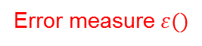
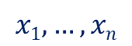
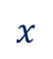
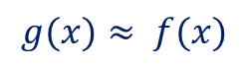
The learning diagram
$$x1,…,xn$$
Unknown input distribution
$$P(X)$$
Unknown input distribution
𝑃(𝑋)
Learning Algorithm
A
Unknown target distribution $P(y|X)$
target function f: X→Y plus noise
Unknown target distribution 𝑃(𝑦|𝑋)
target function f: X→Y plus noise
Final Hypothesis
g: X→Y
Training examples
$$(x1,y1)…(xn,yn)$$
Training examples
(𝑥_{1,}𝑦₁)…(𝑥_{𝑛,}𝑦_{𝑛})
Hypothesis Set
H
$$x$$
Error measure $ε()$
$$g(x)≈ f(x)$$
Based on Y. S. Abu-Mostafa, H.-T. Lin, M. Magdon-Ismail, “Learning From Data”, p.30

Slide 17


Generalization
Most learning algorithms fit their models to the training set, but what we really care about is generalization error, or expected error on unseen examples.
Generalization is ability to perform well on unseen data, is what Machine Learning is ultimately about.
Why should doing well on the training set tell us anything about generalization error? Can we prove that learning algorithms will work well?

Slide 18
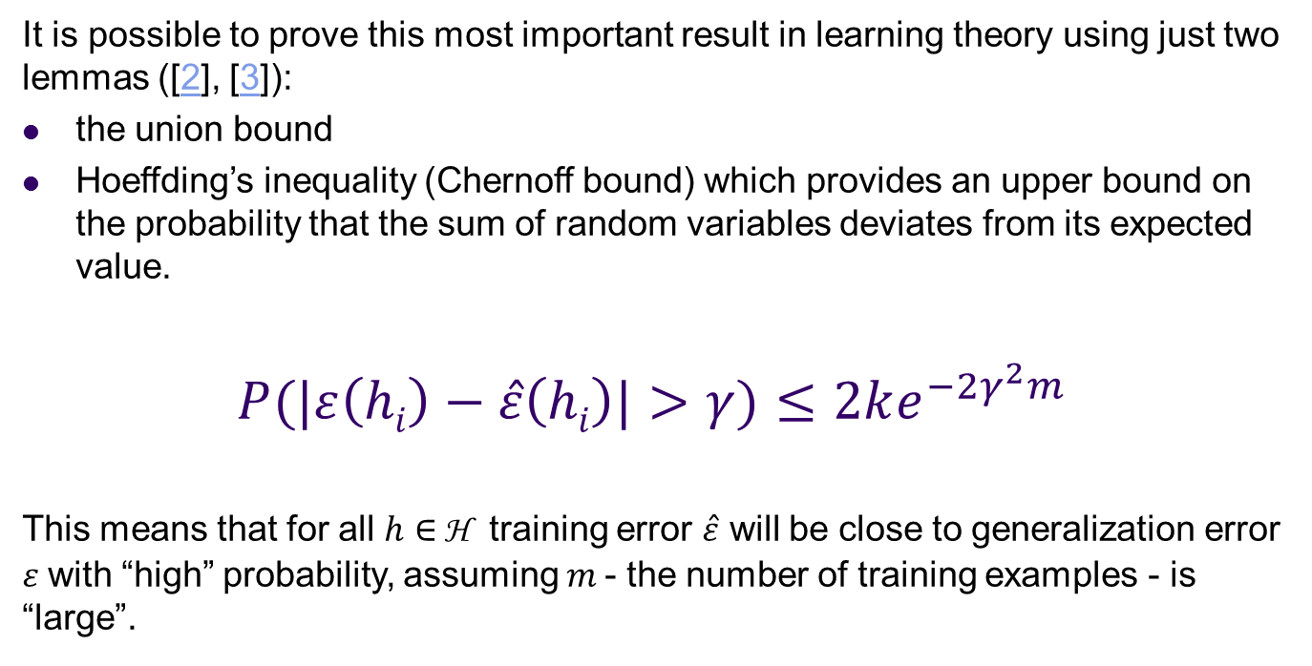
Hoeffding’s inequality
It is possible to prove this most important result in learning theory using just two lemmas ([2], [3]):
the union bound
Hoeffding’s inequality (Chernoff bound) which provides an upper bound on the probability that the sum of random variables deviates from its expected value.
$$P(|ε\left(hi\right)−\hat{ε}\left(hi\right)|>γ)≤2ke^{−2γ^{2}m}$$
This means that for all $h∈$ H training error $\hat{ε}$ will be close to generalization error $ε$with “high” probability, assuming $m$- the number of training examples - is “large”.

Slide 19
iid assumption
Note that Hoeffding’s inequality does not make any prior assumption about the data distribution. Its only assumption is that the training and testing data are independent and identically distributed (iid) random variables drawn from the same distribution D
The assumption of training and testing on the same distribution is the most important in a set of assumptions under which numerous results on learning theory were proved.

Slide 20
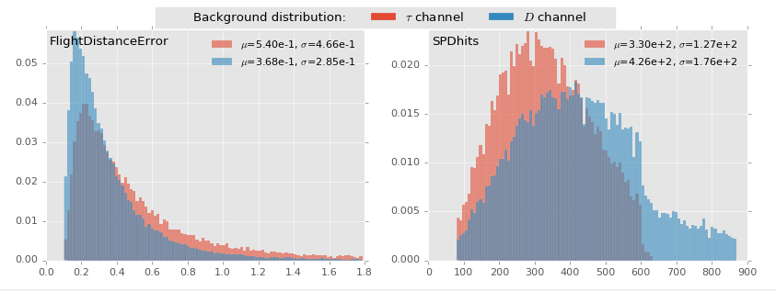
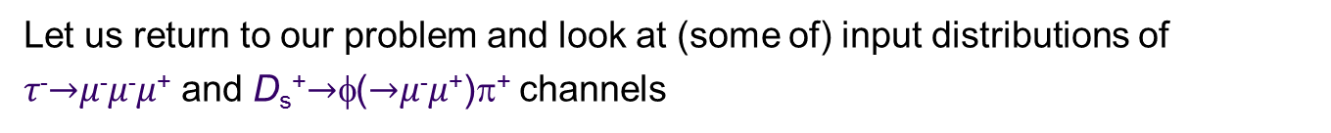
Comparison of experimental and control channels
Let us return to our problem and look at (some of) input distributions of
𝜏⁻$→$𝜇⁻𝜇⁻𝜇⁺ and D_{s}⁺$→$φ($→$𝜇⁻𝜇⁺)π⁺ channels

Slide 21
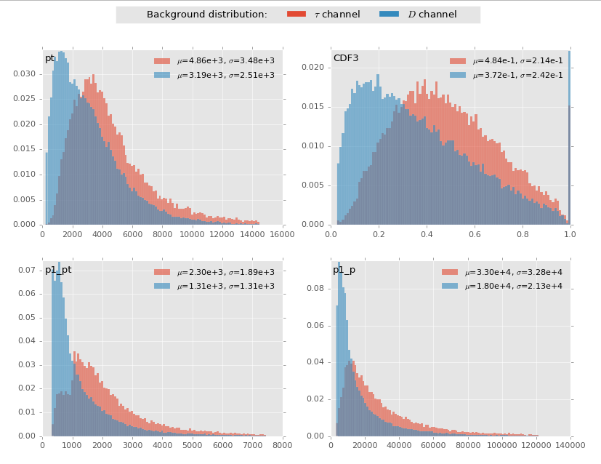

Slide 22
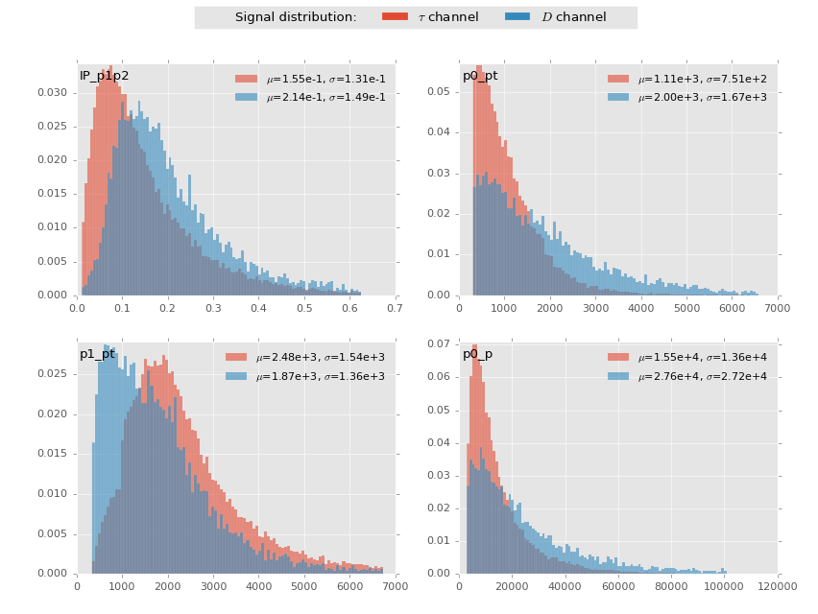

Slide 23
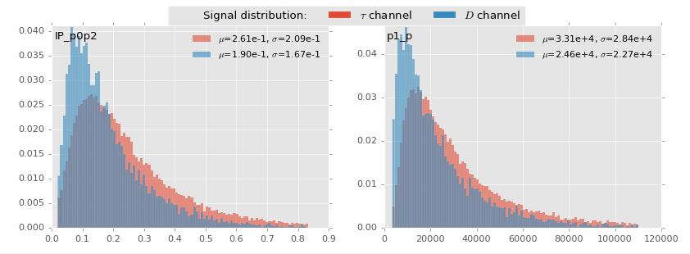
The distributions are different
It is evident that the underlying probability distributions significantly differ between the two channels, therefore violating the assumption of a single underlying generative process between the train set and the test set, which is the cornerstone of statistical learning and, in general, of inference.

Slide 24
What does it mean for us?
Practically this means that Kolmogorov–Smirnov test on a data with another distribution provides no additional guarantee [in statistical sense] for a model - neither on signal channel where a model was trained, nor on control channel where a model was not trained.
To draw a conclusion from different distribution that did not participate in inference is generally useless - as long as we hold on Machine Learning paradigm.

Slide 25
3. Kolmogorov–Smirnov test
Before we propose a solution to the problem of different distributions let us review nuances of Kolmogorov–Smirnov test that played interesting role in this competition.

Slide 26
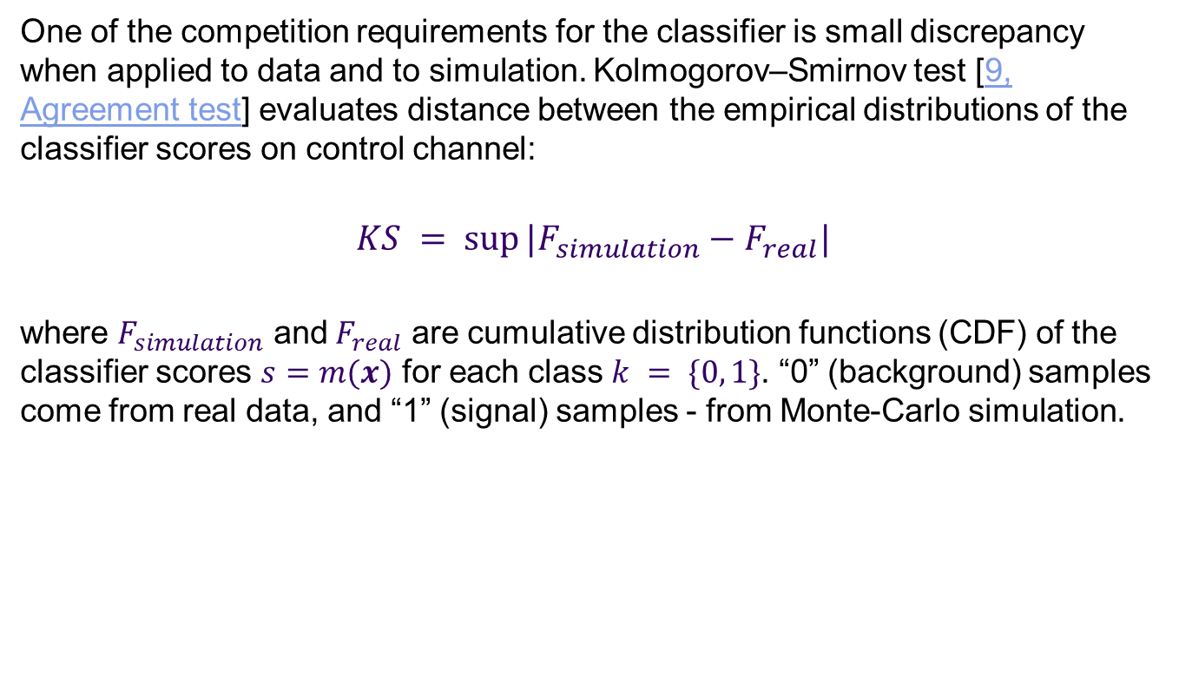
Kolmogorov–Smirnov test
One of the competition requirements for the classifier is small discrepancy when applied to data and to simulation. Kolmogorov–Smirnov test [9, Agreement test] evaluates distance between the empirical distributions of the classifier scores on control channel:
$$KS = sup⁡|F_{simulation}−F_{real}|$$
where $F_{simulation}$ and$F_{real}$ are cumulative distribution functions (CDF) of the classifier scores $s=m(x)$ for each class $k = \{0, 1\}$. “0” (background) samples come from real data, and “1” (signal) samples - from Monte-Carlo simulation.

Slide 27
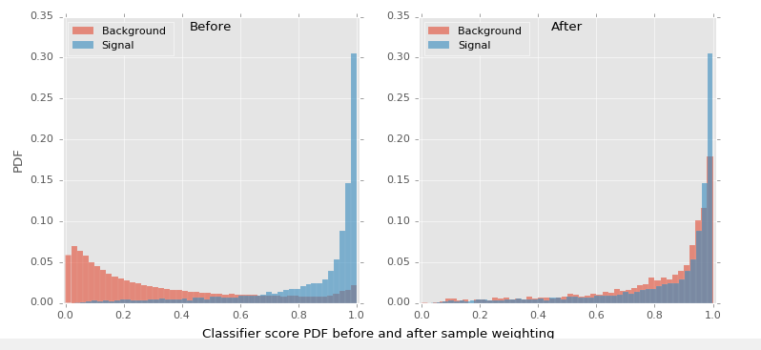
Testing background and signal agreement
Distributions of signal and background scores are naturally different. To compare them in KS-test, background samples being scaled by pre-computed weighs obtained from what can be termed a reference classifier for control channel [Agreement test, 10]

Slide 28
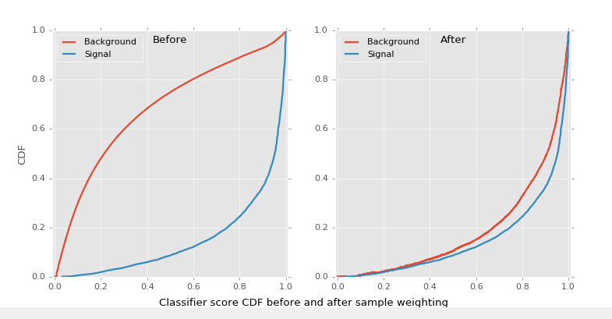
Testing background and signal agreement (continued)
KS statistic

Slide 29
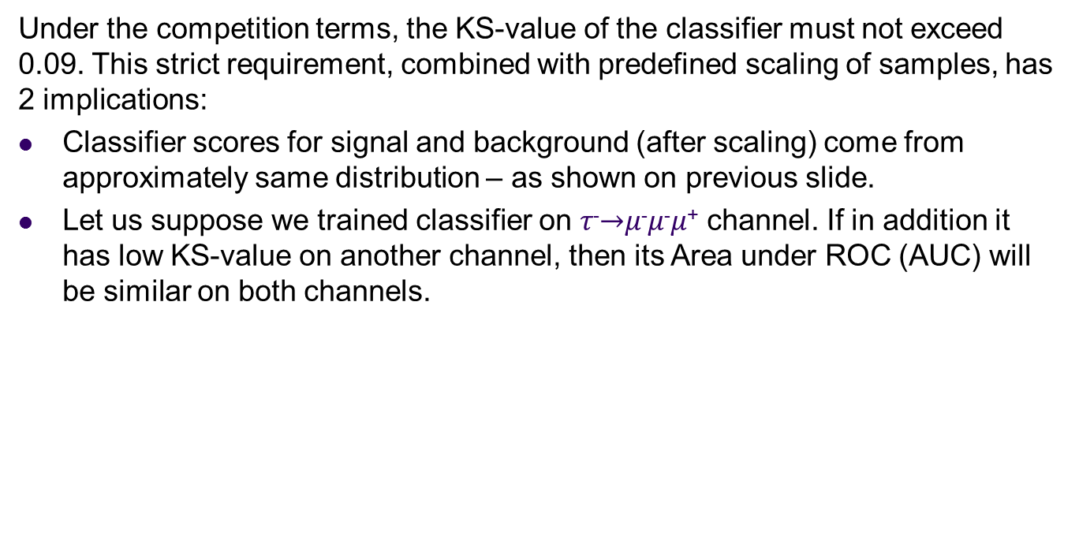
What low KS-values result in?
Under the competition terms, the KS-value of the classifier must not exceed 0.09. This strict requirement, combined with predefined scaling of samples, has 2 implications:
Classifier scores for signal and background (after scaling) come from approximately same distribution – as shown on previous slide.
Let us suppose we trained classifier on 𝜏⁻$→$𝜇⁻𝜇⁻𝜇⁺ channel. If in addition it has low KS-value on another channel, then its Area under ROC (AUC) will be similar on both channels.

Slide 30
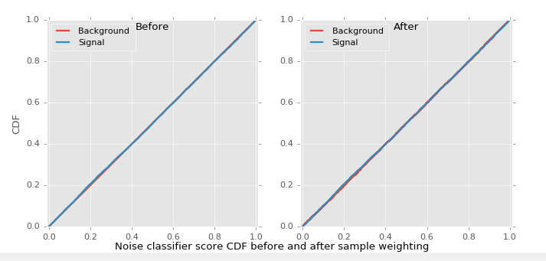
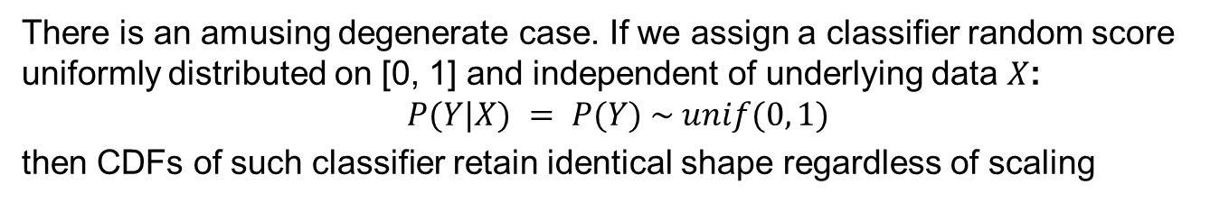
A degenerate case
There is an amusing degenerate case. If we assign a classifier random score uniformly distributed on [0, 1] and independent of underlying data $X$:
$$P(Y|X) = P(Y) \sim unif(0, 1)$$
then CDFs of such classifier retain identical shape regardless of scaling

Slide 31
A degenerate case (continued)
Not affected by sample weighting, such “classifier” can easily pass KS-test on control channel. To demonstrate this phenomenon, author of this presentation implemented a simple model, combination of strong classifier and random noise, that reaches top score, satisfies all competition requirements (no training on control data, pass all tests, treat both channels as the same).
Yet by construction this model is meaningless on control channel which is de facto controlled by random classifier. And though the model passes KS test on control channel, this test makes no sense for signal channel which is controlled by strong classifier. Please see this discussion for details.
Of course, this is very artificial example, but it shows practical evidence against testing on different distribution.

Slide 32
4. Solution: transfer learning

Slide 33
Preamble
The idea of attesting model on control channel is certainly reasonable and can be implemented in theoretically sound way. In Machine Learning the problem of different data sets is well known, and solution is called Transfer learning. It aims at transferring knowledge from a model created on the train data set to the test data set, assuming they differ in some aspects, e.g. in distribution.

Slide 34
Transfer learning applications
The need for data set adaptation arises in many Machine Learning applications. For example, spam filters can be trained on some public collection of spam, but when applied to an individual mail box may require personalization, i.e. adaptation to specific distribution of emails.
Medicine is another field for transfer learning, as models trained on general population do not fit well individual subjects. The solution is to transfer such models to individuals with adaptation. Brain-computer interface (BCI) is another example of successful application of transfer learning [4]
One common characteristic of these problems is that target domain of interest either has different distribution and little or no labeled data, or is unavailable at training time at all.

Slide 35
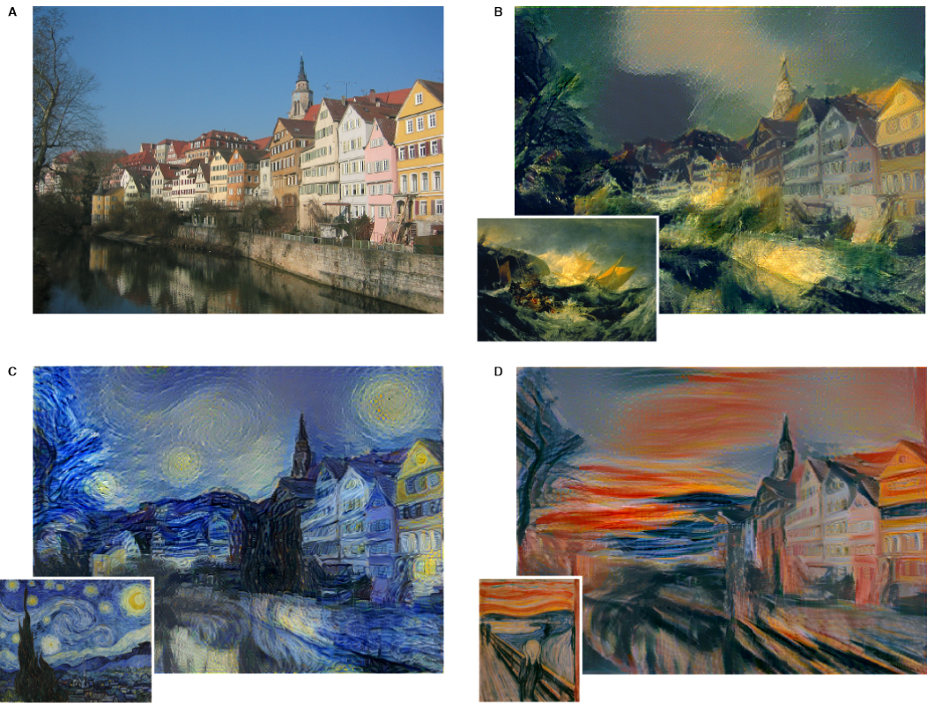
Example
Often domain adaptation is hidden in disguise of unsupervised features learning. It is common practice to apply convolutional filters acquired from some image- or audio data set to another data set, sometimes from different domain.
Example of artistic style transfer. From “A Neural Algorithm of Artistic Style”, link

Slide 36
Setting our goals
Our goal is formulated as follows: we have data from two channels of similar topology and different distribution. The first channel we consider “reliable” (well-studied behavior, reliable data), the second – “experimental” (less reliable data). We use “reliable” channel to train logistic regression classifier and test it on “experimental” channel. Besides that, we want our classifier to satisfy some additional criteria, like KS and CvM tests.

Slide 37
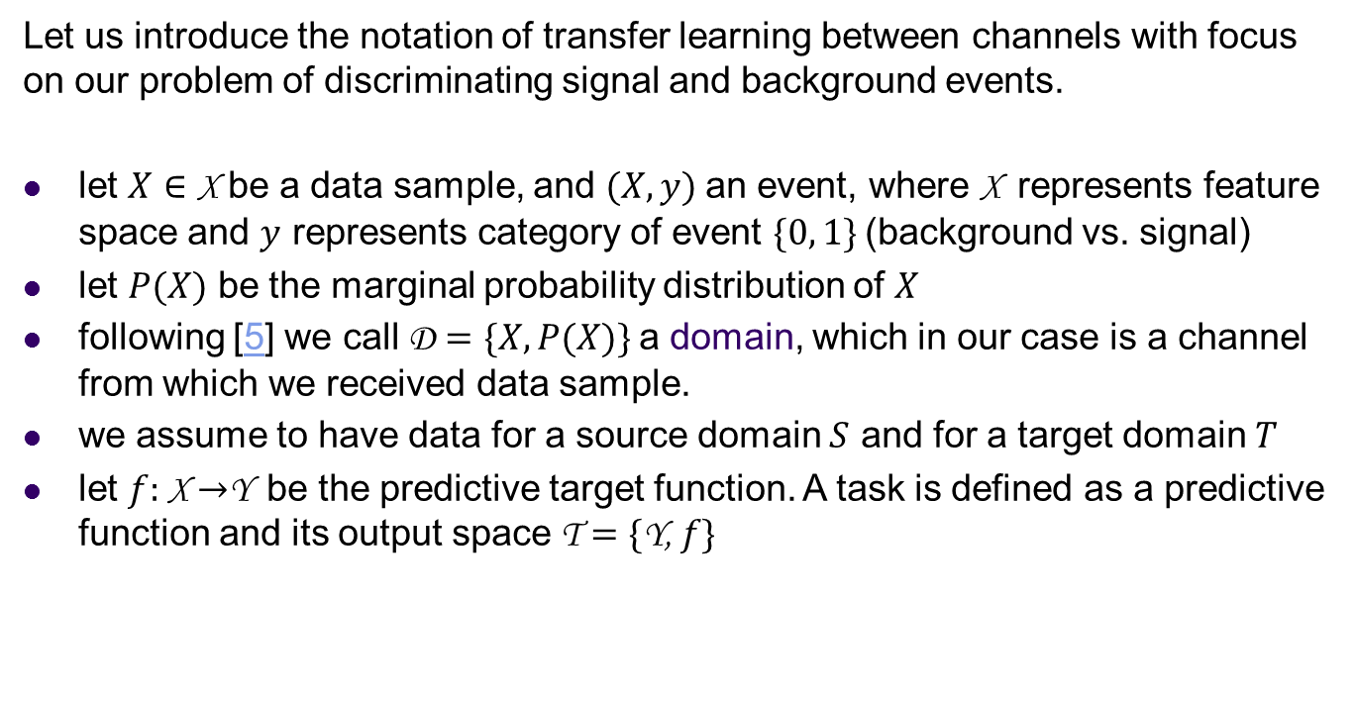
Definitions
Let us introduce the notation of transfer learning between channels with focus on our problem of discriminating signal and background events.
let $X∈$ X be a data sample, and $(X, y)$an event, where X represents feature space and $y$ represents category of event $\{0, 1\}$(background vs. signal)
let $P(X)$ be the marginal probability distribution of $X$
following [5] we call D $=\{X, P(X)\}$a domain, which in our case is a channel from which we received data sample.
we assume to have data for a source domain $S$ and for a target domain $T$
let $f:$ X $→$Y be the predictive target function. A task is defined as a predictive function and its output space T $=\{$Y,$f\}$

Slide 38
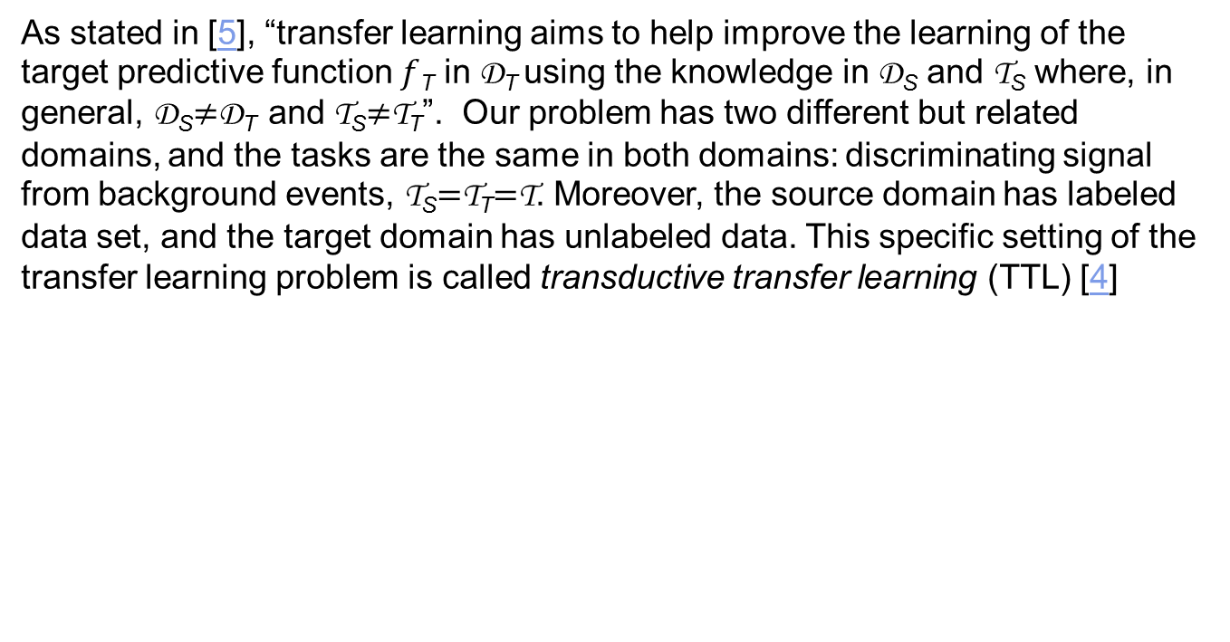
Transductive Transfer Learning
As stated in [5], “transfer learning aims to help improve the learning of the target predictive function $f$_{T} in D_{T} using the knowledge in D_{S} and T_{S} where, in general, D_{S}$≠$D_{T} and T_{S}$≠$T_{T}”. Our problem has two different but related domains, and the tasks are the same in both domains: discriminating signal from background events, T_{S}$=$T_{T}$=$T. Moreover, the source domain has labeled data set, and the target domain has unlabeled data. This specific setting of the transfer learning problem is called transductive transfer learning (TTL) [4]

Slide 39
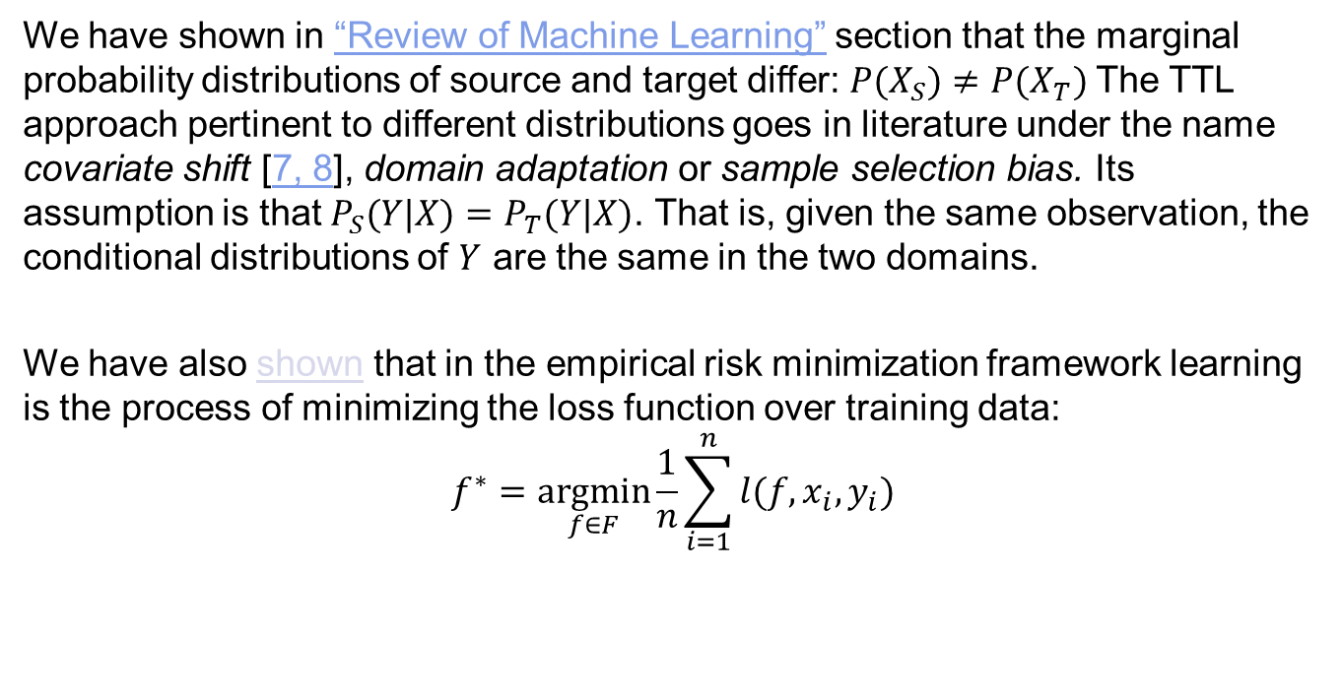
Covariate Shift
We have shown in “Review of Machine Learning” section that the marginal probability distributions of source and target differ: $P(X_{S})≠P(X_{T})$The TTL approach pertinent to different distributions goes in literature under the name covariate shift [7, 8], domain adaptation or sample selection bias. Its assumption is that $P_{S}(Y|X)=P_{T}(Y|X)$. That is, given the same observation, the conditional distributions of $Y$ are the same in the two domains.
We have also shown that in the empirical risk minimization framework learning is the process of minimizing the loss function over training data:
$$f^{∗}=\underset{f∈F}{argmin}{\frac{1}{n}}\sum_{i=1}^{n}{l(f,x_{i},y_{i})}$$

Slide 40
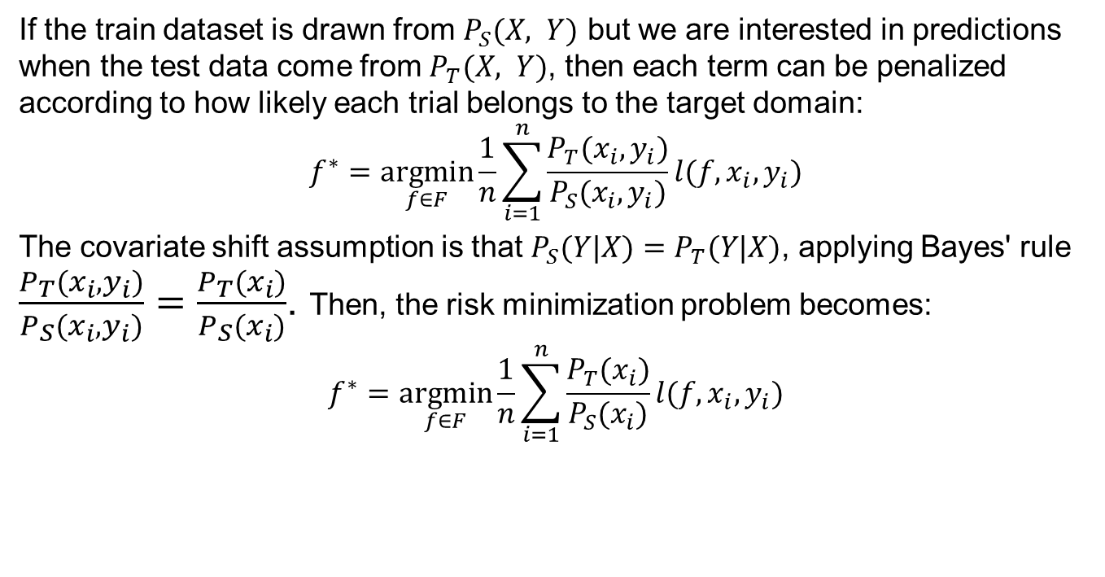
TTL framework
If the train dataset is drawn from $P_{S}(X, Y)$ but we are interested in predictions when the test data come from $P_{T}(X, Y)$, then each term can be penalized according to how likely each trial belongs to the target domain:
$$f^{∗}=\underset{f∈F}{argmin}{\frac{1}{n}}\sum_{i=1}^{n}{\frac{P_{T}(x_{i},y_{i})}{P_{S}(x_{i},y_{i})}l(f,x_{i},y_{i})}$$
The covariate shift assumption is that $P_{S}(Y|X)=P_{T}(Y|X)$, applying Bayes' rule $\frac{P_{T}(x_{i},y_{i})}{P_{S}(x_{i},y_{i})}=\frac{P_{T}(x_{i})}{P_{S}(x_{i})}$. Then, the risk minimization problem becomes:
$$f^{∗}=\underset{f∈F}{argmin}{\frac{1}{n}}\sum_{i=1}^{n}{\frac{P_{T}(x_{i})}{P_{S}(x_{i})}l(f,x_{i},y_{i})}$$

Slide 41
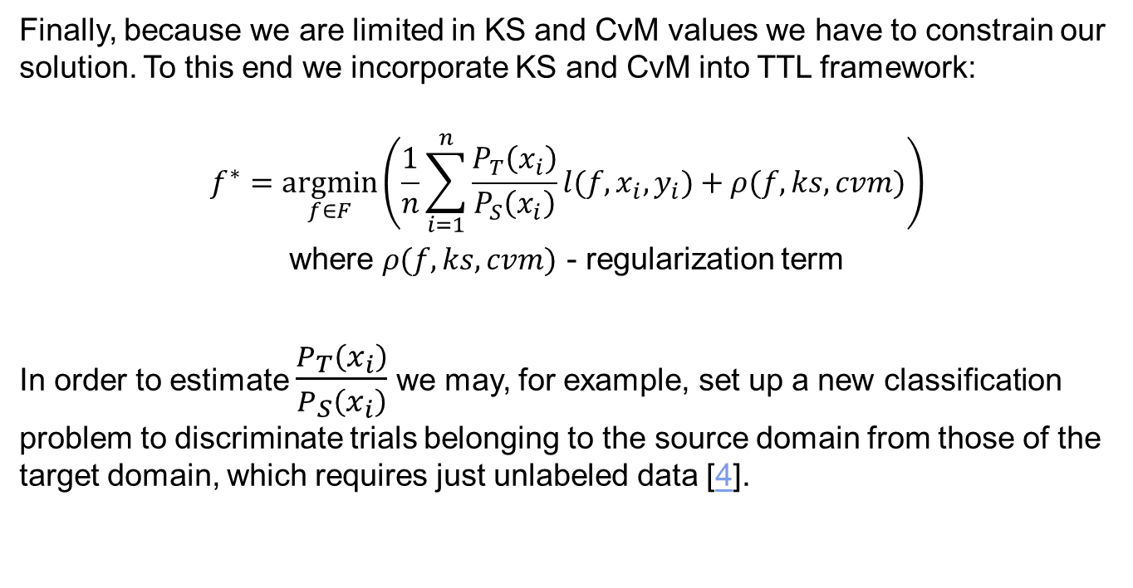
Constraining the model on KS and CvM values
Finally, because we are limited in KS and CvM values we have to constrain our solution. To this end we incorporate KS and CvM into TTL framework:
$$f^{∗}=\underset{f∈F}{argmin}\left(\frac{1}{n}\sum_{i=1}^{n}{\frac{P_{T}\left(x_{i}\right)}{P_{S}\left(x_{i}\right)}l(f,x_{i},y_{i})}+ρ(f,ks,cvm)\right)$$
where $ρ(f,ks,cvm)$ - regularization term
In order to estimate $\frac{P_{T}\left(x_{i}\right)}{P_{S}\left(x_{i}\right)}$ we may, for example, set up a new classification problem to discriminate trials belonging to the source domain from those of the target domain, which requires just unlabeled data [4].

Slide 42
5. Implementation

Slide 43
Implementation
For the competition we have submitted several different models. The transfer learning model achieved AUC = 0.996802 on Public Leader Board. It was improved to 0.998150 post competition. Source code can be downloaded from GitHub page https://github.com/alexander-rakhlin/flavours-of-physics
As we remember, training on control data was prohibited by the competition requirements, what dictated us significant amendments to the Transductive Transfer Learning framework outlined in Section 4.
Our implementation is specific in transfer learning direction: it goes from less reliable data (signal channel considered less reliable) to more reliable control channel. Reverse direction would be more natural. Another difference is how domain adaptation was implemented: instead of covariate shift we do calibration.

Slide 44
Initial training
We implemented two-stage process: initial training and adaptation stage.
On the initial stage the model is trained for maximum performance on labeled data from signal channel. This model is based on ensemble of 20 feed forward fully connected neural nets written in Python with Keras library. Each net comprises 4 fully connected hidden layers F1-F4 with PReLU activations fed to a 2-way softmax output layer which produces a distribution over the 2 class labels. The hidden layers contain 75, 50, 30, and 25 neurons respectively. To avoid overfitting, dropout is used in F1, F2 and F3 layers:

Slide 45

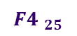


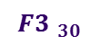


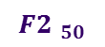

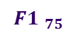
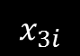

Neural Net architecture
$$x_{1}$$
Dropout
PReLU unit
$$x_{2}$$
$$x_{3i}$$
$$x_{4}$$
0
$$x_{5}$$
Softmax output
Input layer
1
$$x_{6}$$
…
…
$$x_{7}$$
…
…
…
$${F4 }_{25}$$
$${F3 }_{30}$$
$$x_{n}$$
$${F2 }_{50}$$
$${F1 }_{75}$$

Slide 46
Adaptation stage
On the adaptation stage first Net is fixed, its output is stacked with original features and cascaded to the second net of similar configuration:
Powell search method
Weights (fixed)
First stage Net, already trained on Signal channel
Weights
Experi-mental channel
AUC
KS
Loss
Control channel
Second stage Net

Slide 47
Adaptation stage (continued)
The purpose of the second net is to adopt the model to control channel with minimal and controlled loss of performance. The intuition behind this process can be understood from the picture:
Pic

Slide 48
Training the 2-nd Net
Although training on control channel was prohibited, calculation of KS and CvM values - allowed. The other metric to satisfy is AUC on signal channel. All 3 metrics are global and do not fit stochastic gradient descent method. Therefore we train this second net in a special way:
Initial weights of the second net are set to reproduce output of the first net. This is accomplished after 1-3 epochs of gradient descent with cross entropy loss on signal channel.
Then adaptation of weights is done with help of Powell’s search method in minimize() function from scipy.optimize library.

Slide 49
Training the 2-nd Net (continued)
transductor_train.py
from scipy.optimize import minimize
…
pretrain = True
if pretrain:
# pretrain model
…
model.fit(Xt, yt_categorical, batch_size=64, nb_epoch=1,
validation_data=None, verbose=2, show_accuracy=True)
…
x0 = get_weights(model)
print("Optimize %d weights" % len(x0))
objective = create_objective(model, pt.transductor_model_file,
Xt, yt, Xa, ya, wa, Xc, mc, verbose=True)
minimize(objective, x0, args=(), method='Powell')

Slide 50
Loss function
On the second stage loss function incorporates AUC, KS, CvM metrics:
As a result, we control all three values simultaneously. But the most important thing is that this approach provides statistical guarantee that the model satisfies all target metrics (AUC, KS, CvM) not by coincidence but as a result of Empirical Risk Minimization in their respective domains – in accordance with Machine Learning principles outlined in Section 2.
transductor_train.py
loss = -auc + ks_importance * ks_loss + cvm_importance * cvm_loss

Slide 51
Closing remarks and suggestions
Although the implementation is theoretically correct, we overcomplicated fairly simple Transfer Learning Framework striving to satisfy some competition requirements.
I encourage the Organizers to lift “no training on control channel” requirement and try to create a model on control channel instead of signal channel – following the TTL framework outlined in Section 4.
I suggest to consider transfer learning as a general framework for modeling rare events based on models built in domains with more known and well-observed behavior.

Slide 52
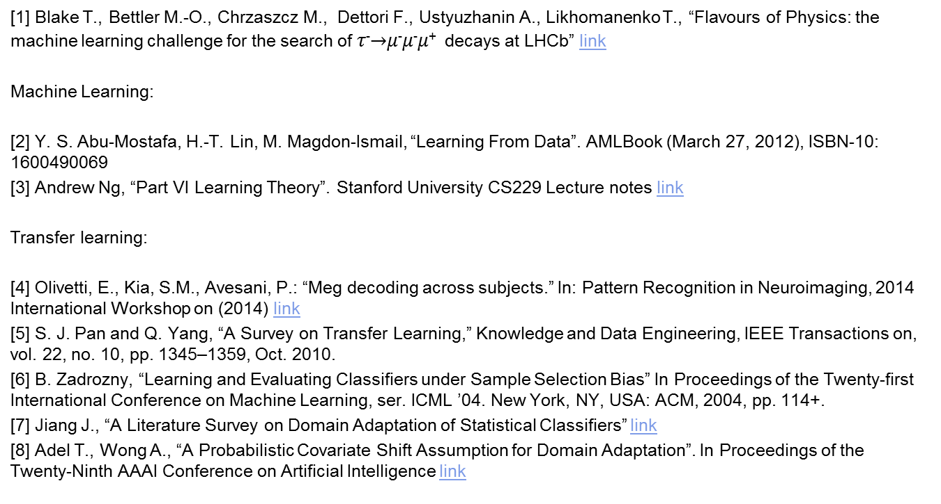
References
[1] Blake T., Bettler M.-O., Chrzaszcz M., Dettori F., Ustyuzhanin A., Likhomanenko T., “Flavours of Physics: the machine learning challenge for the search of 𝜏⁻$→$𝜇⁻𝜇⁻𝜇⁺ decays at LHCb” link
Machine Learning:
[2] Y. S. Abu-Mostafa, H.-T. Lin, M. Magdon-Ismail, “Learning From Data”. AMLBook (March 27, 2012), ISBN-10: 1600490069
[3] Andrew Ng, “Part VI Learning Theory”. Stanford University CS229 Lecture notes link
Transfer learning:
[4] Olivetti, E., Kia, S.M., Avesani, P.: “Meg decoding across subjects.” In: Pattern Recognition in Neuroimaging, 2014 International Workshop on (2014) link
[5] S. J. Pan and Q. Yang, “A Survey on Transfer Learning,” Knowledge and Data Engineering, IEEE Transactions on, vol. 22, no. 10, pp. 1345–1359, Oct. 2010.
[6] B. Zadrozny, “Learning and Evaluating Classifiers under Sample Selection Bias” In Proceedings of the Twenty-first International Conference on Machine Learning, ser. ICML ’04. New York, NY, USA: ACM, 2004, pp. 114+.
[7] Jiang J., “A Literature Survey on Domain Adaptation of Statistical Classifiers” link
[8] Adel T., Wong A., “A Probabilistic Covariate Shift Assumption for Domain Adaptation”. In Proceedings of the Twenty-Ninth AAAI Conference on Artificial Intelligence link

Slide 53
References (continued)
Kolmogorov-Smirnov test:
[9] Wikipedia, “Kolmogorov–Smirnov test” link
[10] Andrew P. Bradley, “ROC Curve Equivalence using the Kolmogorov-Smirnov Test”. The University of Queensland, School of Information Technology and Electrical Engineering, St Lucia, QLD 4072, Australia link

Slide 54
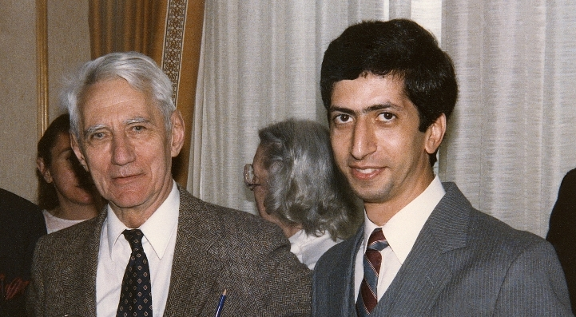
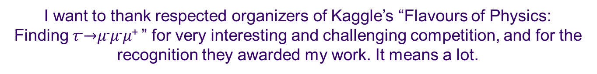
Acknowledgements
This work is dedicated in gratitude to Yaser S. Abu-Mostafa, Professor of Electrical Engineering and Computer Science at the California Institute of Technology. To great mentor, who taught me foundations of Machine Learning.
Claude E. Shannon with a young Yaser Abu-Mostafa
I want to thank respected organizers of Kaggle’s “Flavours of Physics:
Finding 𝜏⁻$→$𝜇⁻𝜇⁻𝜇⁺ ” for very interesting and challenging competition, and for the recognition they awarded my work. It means a lot.
Thank you for your attention!

